Slide 1
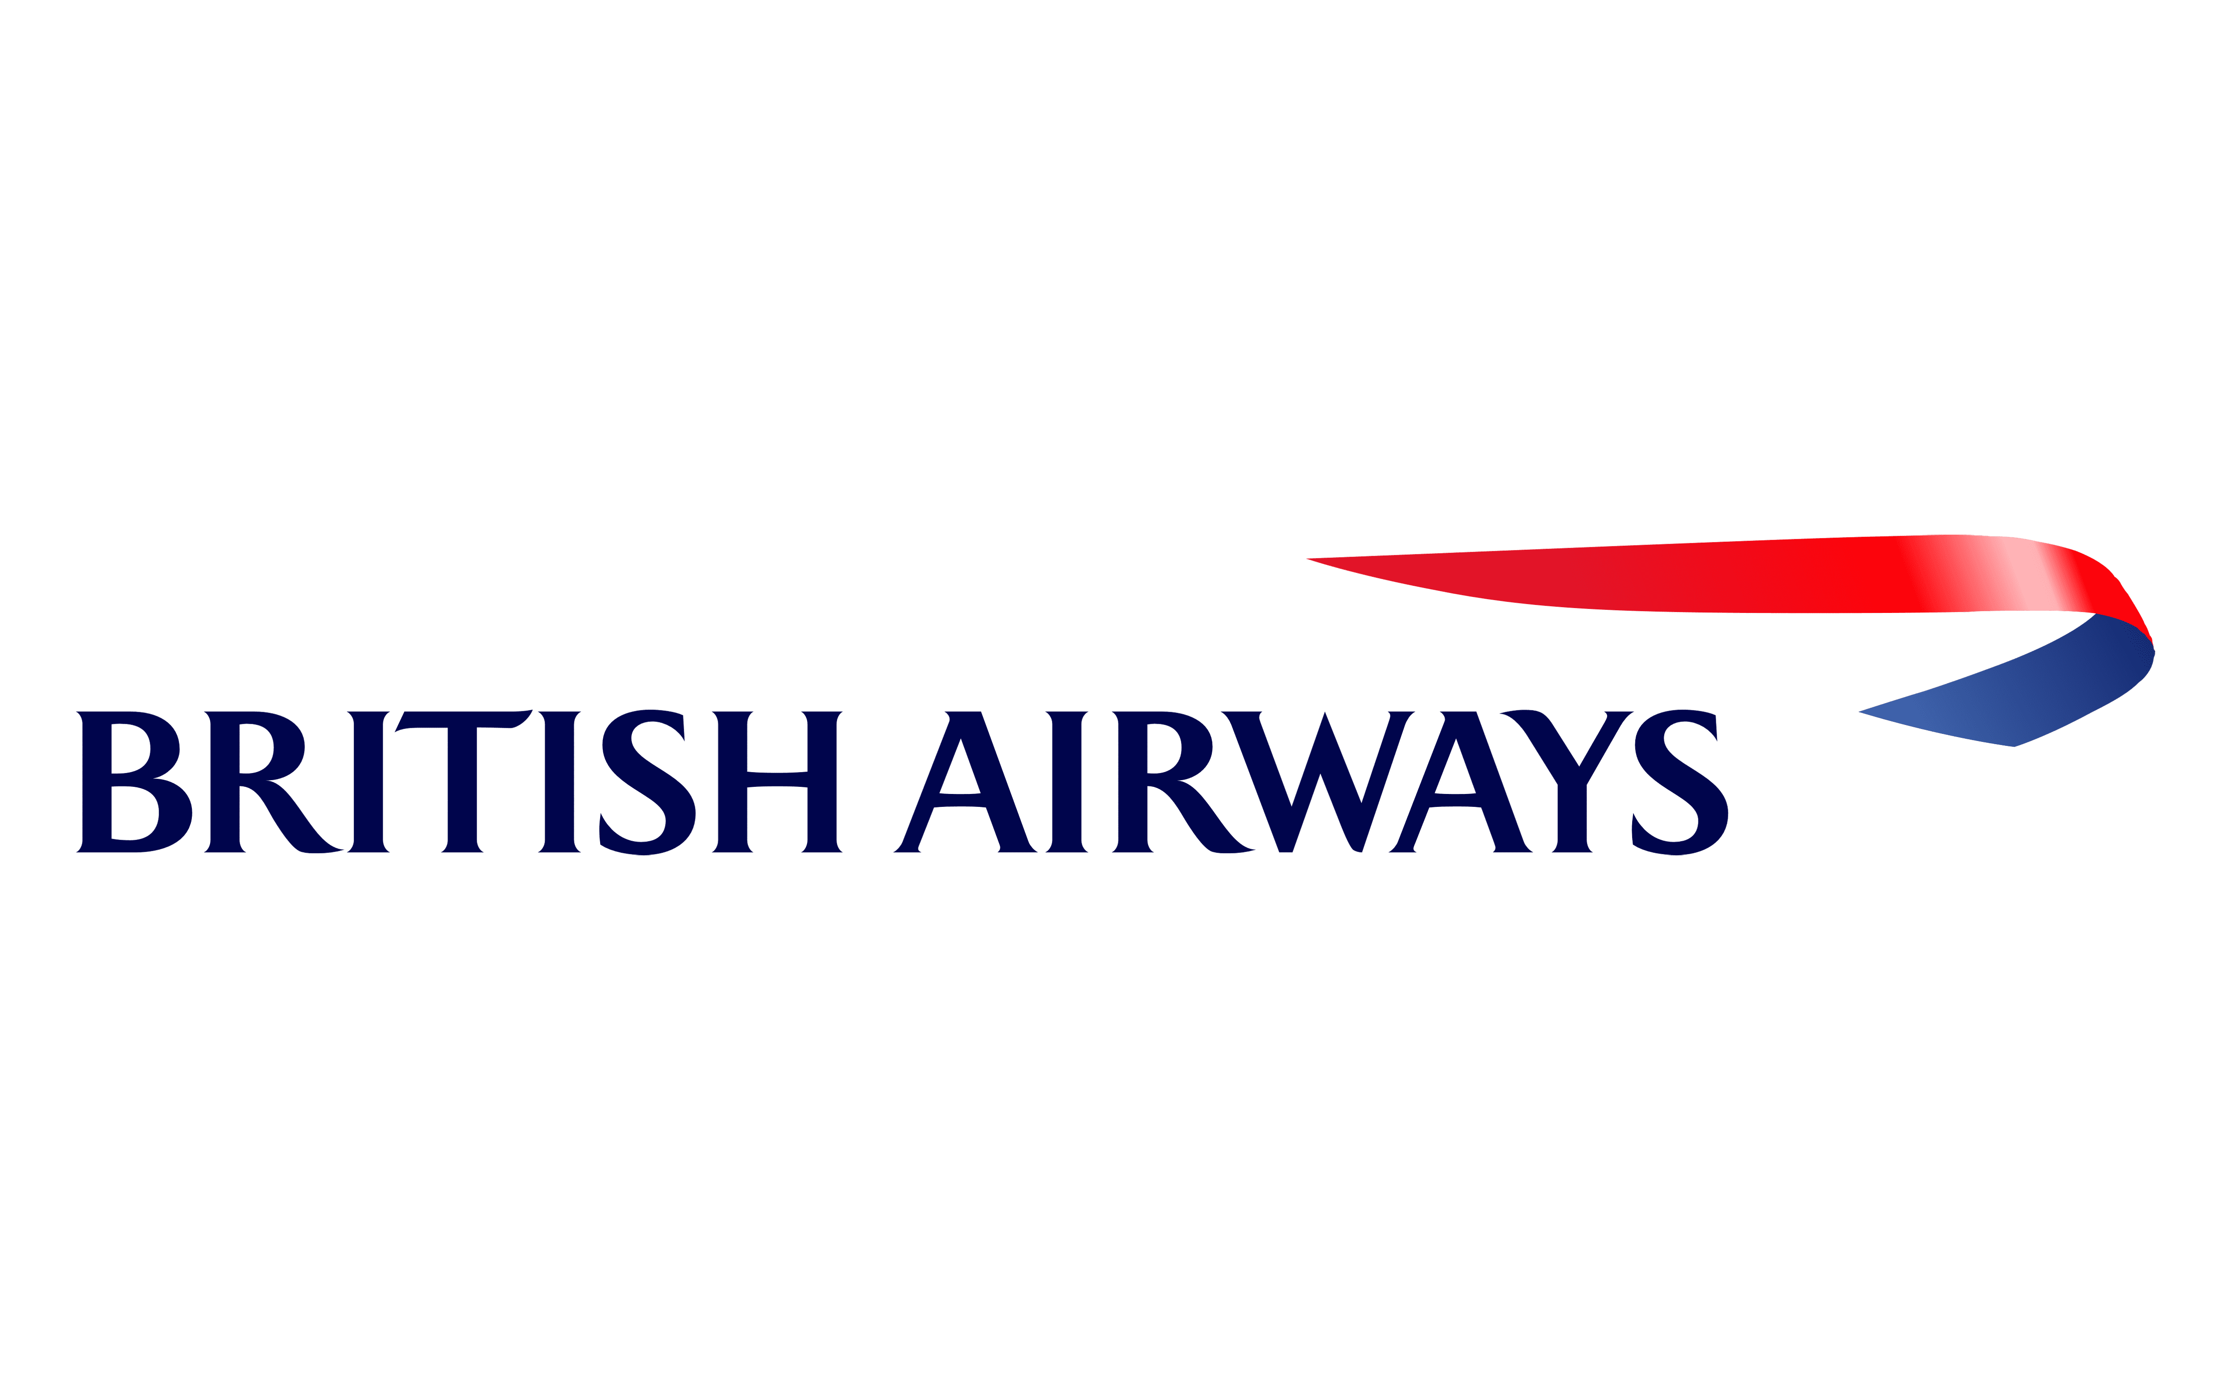

British Airways: Skytrax Customer Review Analysis

Slide 2
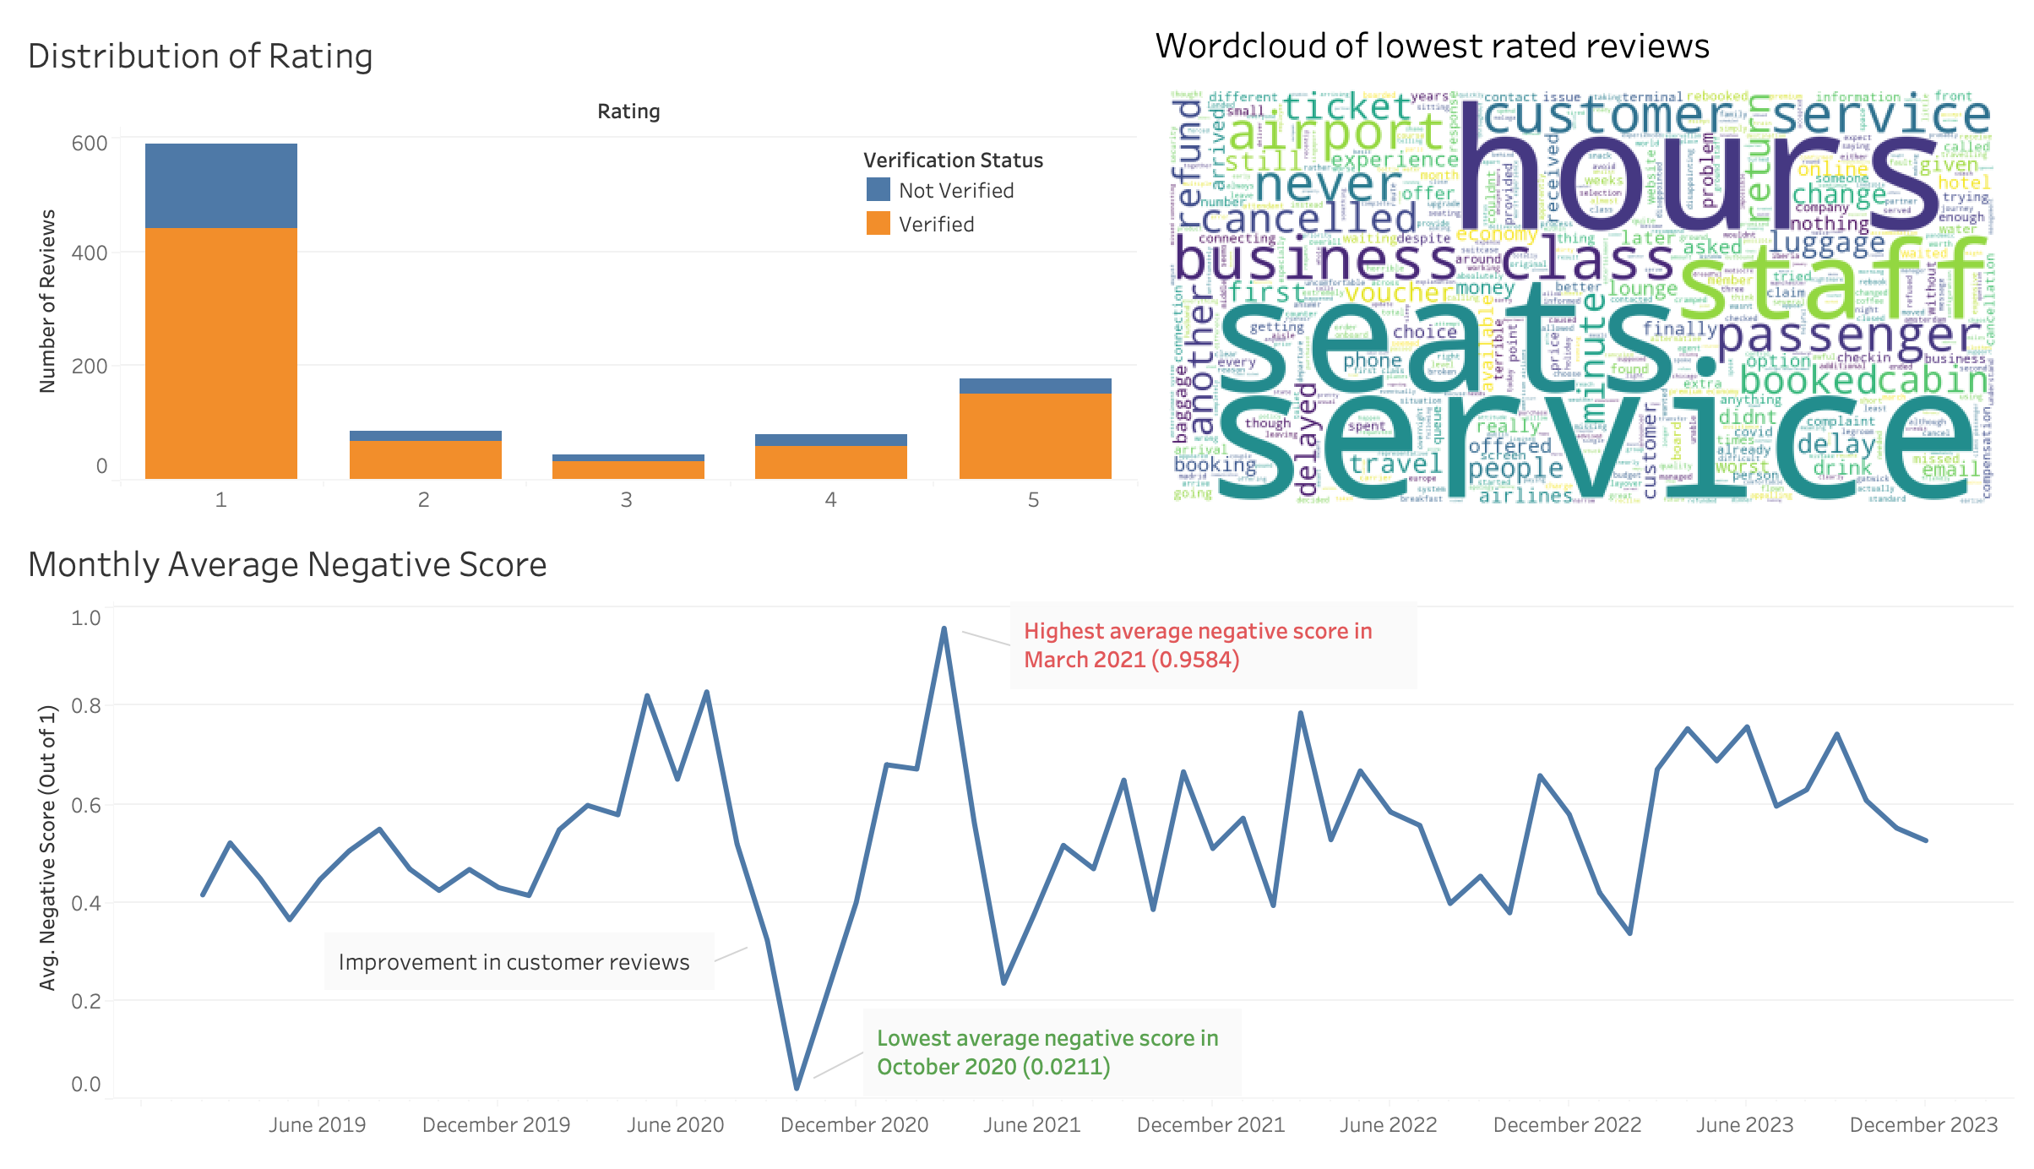
Key Insights from Customer Reviews
Most reviews have a low rating of 1 out if 5, highlighting widespread customer dissatisfaction.
Common issues are focused on service, seats, staff, and refunds.
Negative sentiment peaked in March 2021, while the most positive feedback was observed in October 2020

